Slide 1
Pandas data
analysis project

Slide 2
Introduction

Slide 3
This analysis investigates a dataset containing information on job roles, companies, salaries, locations, employment status, and additional factors such as company rating. The primary goal is to uncover patterns and insights in salary distributions, job trends, and regional salary differences, providing valuable information for job seekers, employers, and industry analysts.

Slide 4
Data Overview

Slide 5
Data structure
Key Columns:
Rating: Company rating from 0 to 5.
Company Name: The name of the company listing the job..
Job Title: Title of the listed job.
Salary: Salary associated with each job role
Salaries Reported: Number of individuals reporting their salary for this job
Location: City of the job posting.

Slide 6
missing value
All columns are fully populated, with no missing values.
Data type
Numeric and categorical data types align with the dataset requirements. No transformations were needed.

Slide 7
Data cleaning
Duplicate Records:
No duplicate rows were found in the dataset, ensuring that each entry represents unique job data.
Outlier Analysis:
Salary outliers were examined to understand potential anomalies in pay ranges. Outliers may represent high-level executive roles or specialized positions, and extreme outliers were reviewed without removal to maintain dataset integrity.

Slide 8
Feature enginneering
Salary Range: Categorized salaries into "Low", "Medium", and "High" ranges for easier segmentation.
def categorize_salary(salary):
if salary < 400000:
return 'Low'
elif 400000 <= salary <= 800000:
return 'Medium'
else:
return 'High'
df['Salary Range'] = df['Salary'].apply(categorize_salary)

Slide 9
Loctaion category: This function categorizes locations into "Metropolitan" and "Non-Metropolitan" based on a predefined list of metropolitan cities.
def categorize_location(location):
metro_cities = ['Bangalore', 'Mumbai', 'Delhi', 'Hyderabad', 'Chennai', 'Pune', 'Kolkata']
if location in metro_cities:
return 'Metropolitan'
else :
return 'Non-Metropolitan'
df['Location Category'] = df['Location'].apply(categorize_location)

Slide 10
Univariate Analysis
Statistical analysis
Salary:
Mean: ₹695,387
Median: ₹500,000
Mode: ₹300,000
Standard Deviation: ₹884,399, indicating a wide range of salaries with significant variability.

Slide 11
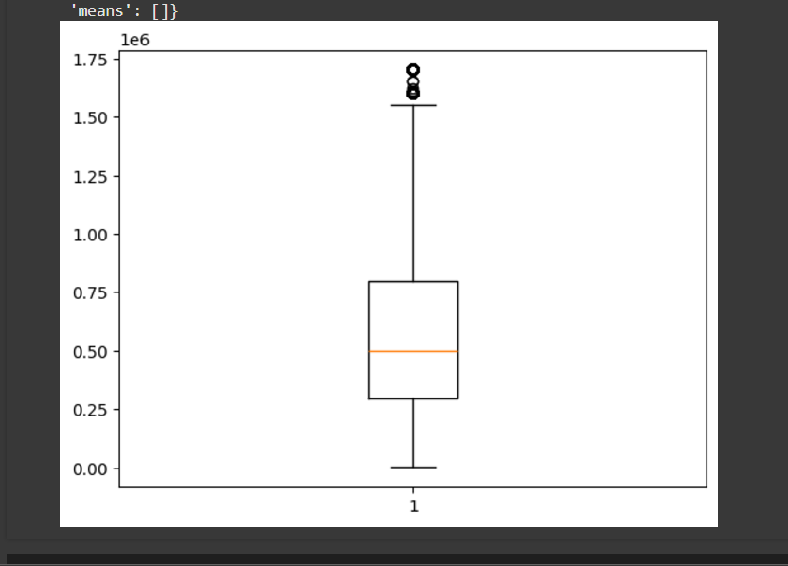
Visual Analysis
Bar plot
Bar plots are used to visualize the distribution of categorical data, comparing frequencies or aggregated measures such as mean or median across categories.
plt.boxplot(df['Salary'])

Slide 12
Histogram
Histograms are used to understand the distribution of numerical data by dividing it into bins and visualizing the frequency of data points in each bin.
for i in num:
plt.hist(df[i])
plt.title(f'hist plot of {i}')
plt.xlabel(f'{i}')
plt.ylabel('frequency')
plt.show()

Slide 13
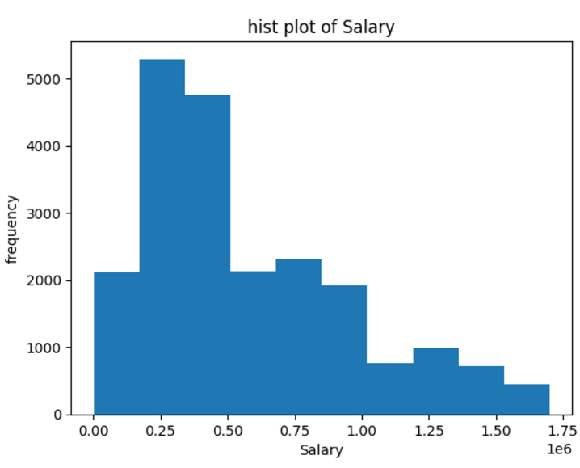
Salary distribution

Slide 14
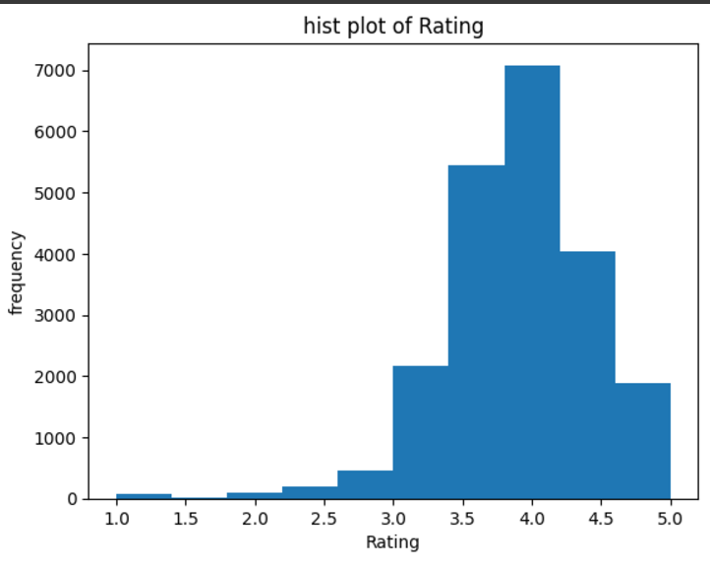
salary rating

Slide 15
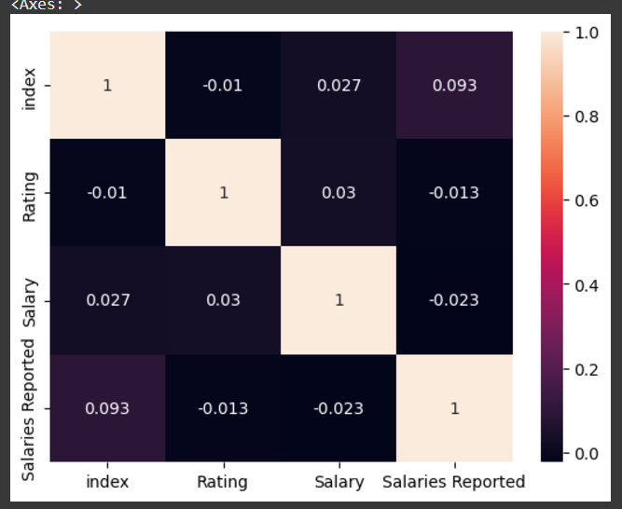
Correlation
A correlation heatmap visualizes the relationships between numerical variables, helping to identify features that strongly influence each other
cor=df.corr(numeric_only=True)
sns.heatmap(cor,annot=True)

Slide 16
Findings
Salary Range:The majority of roles fall within the "Low" (below ₹400,000) and "Medium" (₹400,000-₹800,000) salary ranges.
This distribution implies that most roles in this dataset are mid-level positions, with relatively fewer high-paying jobs, potentially indicating a focus on entry to mid-level tech positions or support role
Location Category:Metropolitan cities show significantly higher average salaries compared to non-metropolitan areas
Major tech hubs like Bangalore, Mumbai, and Delhi drive the metropolitan salary averages higher, which aligns with industry demand and the high cost of living in these regions.

Slide 17
Job Popularity:Software Engineer", "Data Analyst", and "Data Scientist" are the most frequently listed roles, suggesting that these are high-demand roles across multiple companies.
Common job roles tend to correlate with entry-level or mid-level salaries, potentially indicating market saturation or high demand in tech fields.
Salary per Rating:Companies with higher ratings tend to offer slightly higher
salaries
The correlation suggests that reputable companies may offer better compensation packages. However, the relationship is moderate, implying that factors other than rating (such as role specialization) also play a significant role in salary

Slide 18
Location Average Salary:Locations like Bangalore and Mumbai have higher average salaries than other regions.
Locations like Bangalore and Mumbai have higher average salaries than other regions.
Company Size and Salary:Larger companies (with more job listings) show a trend of offering higher average salaries, possibly due to better financial resources and structured pay scales.
Employment Status and Salary:Full-time roles command higher salaries on average than part-time roles, which aligns with the job security and benefits associated with full-time employment.

Slide 19
Key Insights
Specialization Pays: Employees in specialized roles, such as Data Science and Machine Learning, consistently earn higher salaries.
Metropolitan Advantage: Urban centers like Bangalore and Mumbai dominate in terms of both job availability and compensation levels.
Experience Matters: Career progression has a direct impact on earning potential, making skill development crucial.
Demand vs. Reward: While popular roles like Software Developer are in high demand, they don't always align with the highest salaries.
Satisfaction Trends: Highly-rated companies provide a favorable working environment but may not always offer the highest salaries.

Slide 20
Thank you

